Slide 1
Hana Shop - Online food Presentation

Slide 2



01
Introduction
Introduction about the project.
02
Project Management
Project model development & Tools, techniques
Agenda
Style
Functional Requirements
03
Functional Requirement of the application.
04
Hardware/Software Requirements
Hardware/Software requirement for the best performance of application.
05
Summary

Slide 3
Introduction

Slide 4


Team Information
Introduction to Team
Team start with 3 member but 1 member can not be unbearable pressure, so now just have 2 member.
Đặng Hoàng Sơn
Trần Khả Gia
Leader
Member
Student ID: SE130448
Student ID: SE130708

Slide 5
Project Introduction
Introduction
Hana shop is an online shop selling drinks/fast food. An application which is needed when everyone can not go out because of COVID-19.
Project Name
Project type
Hana Shop - Online Food.
Website
Website link
Execution time
https://hanashop1.azurewebsites.net/
2 months

Slide 6
Problem definition
Advantage
Easy to use. Nice UI
Disadvantage
Can response slowly because the internet.
Depend on internet.
Advantage
Provide users many supports searching for product their expected.
Disadvantage
Can not run with the best performance on all browser.
Advantage
User can send feedback to a noob product by chat direct with admin.

Slide 7
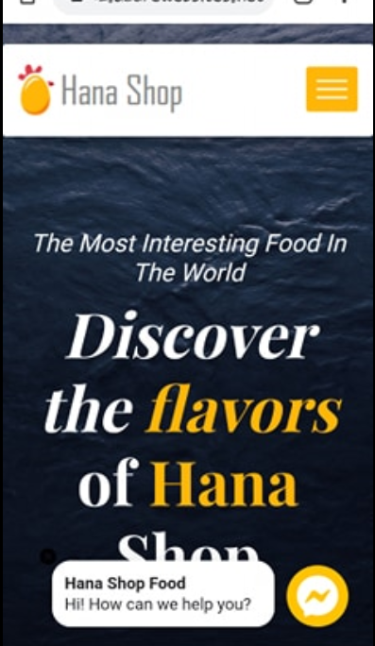
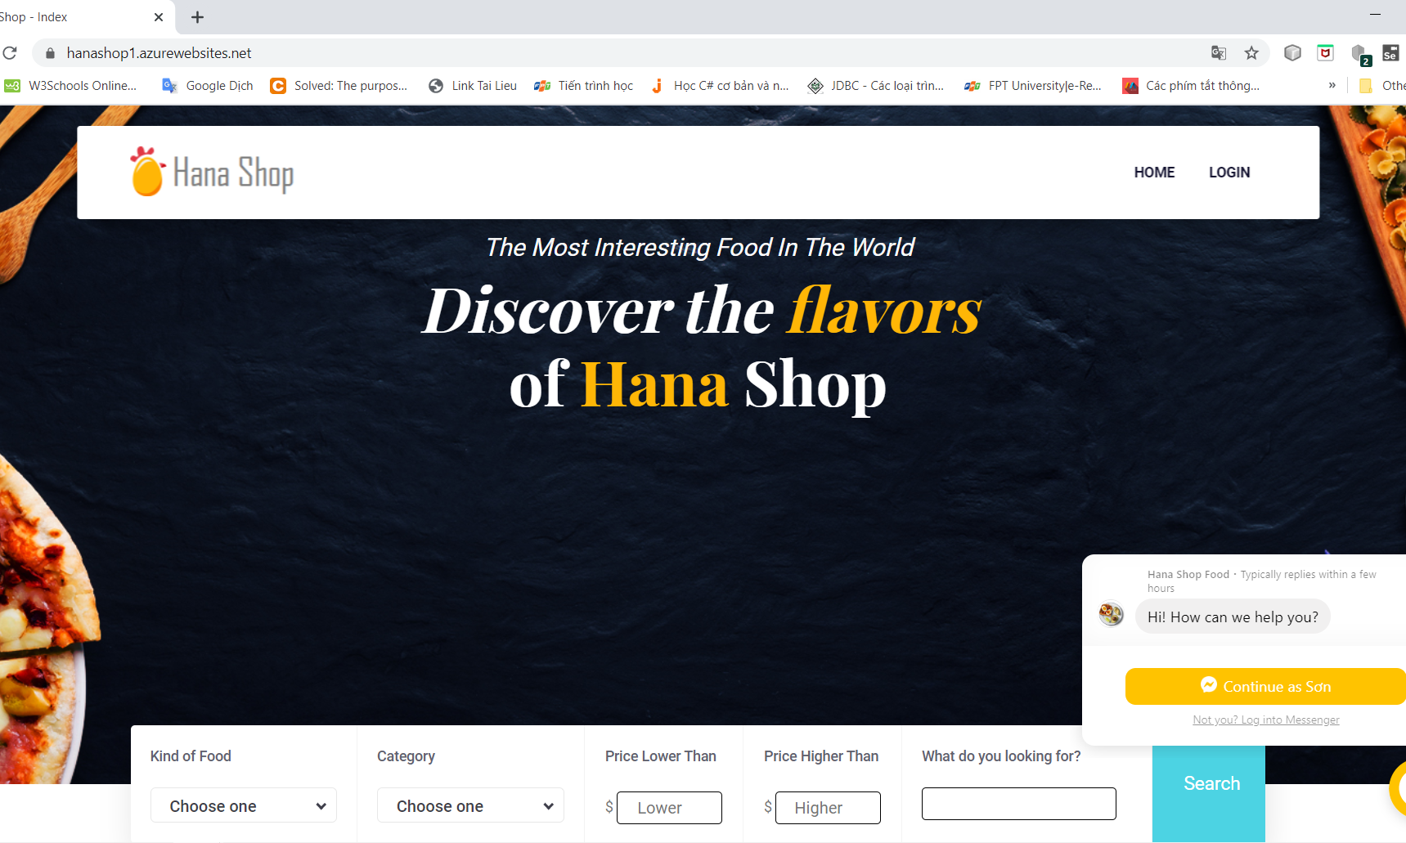
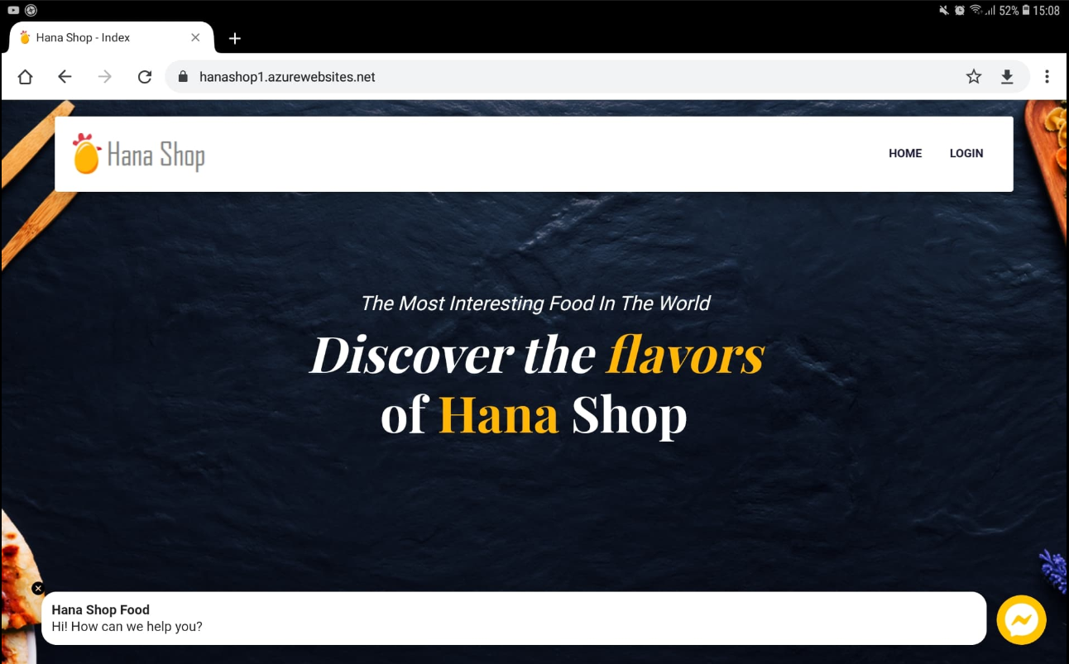

Hardware device
User can use this application on multiple device

Slide 8
Project Management

Slide 9
Timeline
Contents
Contents
Design UI
Test
STEP 1
STEP 2
STEP 3
STEP 4
STEP 5
Contents
Contents
Contents
Design Database.
Code
Release
(Deploy Cloud)

Slide 10






Project Development Model
Based on Agile Model
Requirement
Release
Get a requirement.
Analyze requirement.
Test
FAST
FOOD
Design/Modify Database
Test to validate, verify
Test integrate
Design/modify Database based on requirement.
Development
Architecture and Design Code
.
Design package code, view, model

Slide 11











Tools When Coding
Browser Chrome, Microsoft Edge, Coc Coc
Visual Studio 2019/2017
Place to run Application
Using to code back-end.
Azure DevOps
Using to manage project.
Using to push code.
CI/ CD Project.
SQL Server Management Studio/
Azure Studio
Visual Studio Code
Using to manage database saved in SQL Server.
Using to code front-end.
MongoDB Compass
NoSQL DB
Using to manage database saved in NoSQL Database Server.
Microsoft SQL Server
Using to save database at local.

Slide 12

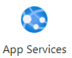
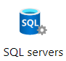
Tools When Release
Azure DevOps
Using to manage project.
Using to push code.
CI/ CD Project.
Microsoft Azure
Using to Cloud service at Microsoft Azure.
SQL Server Management Studio/
Azure Studio
Using to manage database saved in SQL Server.
Azure App Services
Using to deploy application to Cloud
CI/CD Project
MongoDB Compass
Using to manage database saved in NoSQL Database Server.
NoSQL Database
Browser Chrome, Microsoft Edge
Microsoft Azure SQL Server
Using to save database at Cloud.
Place to run Web Application

Slide 13
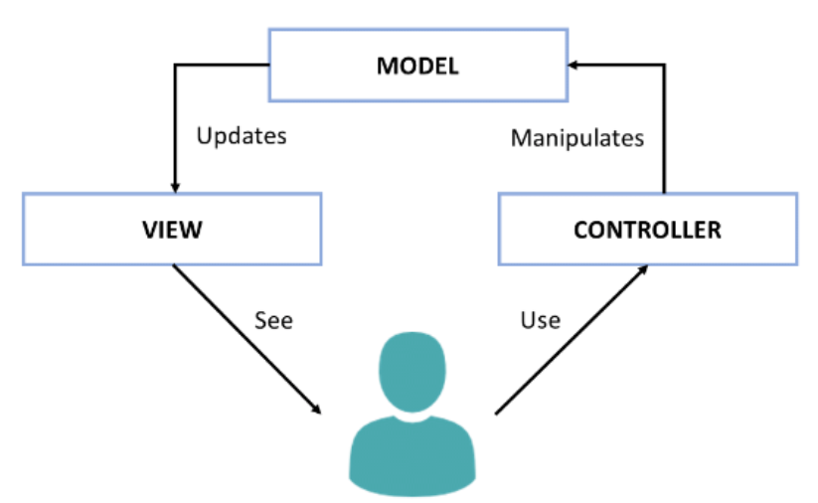
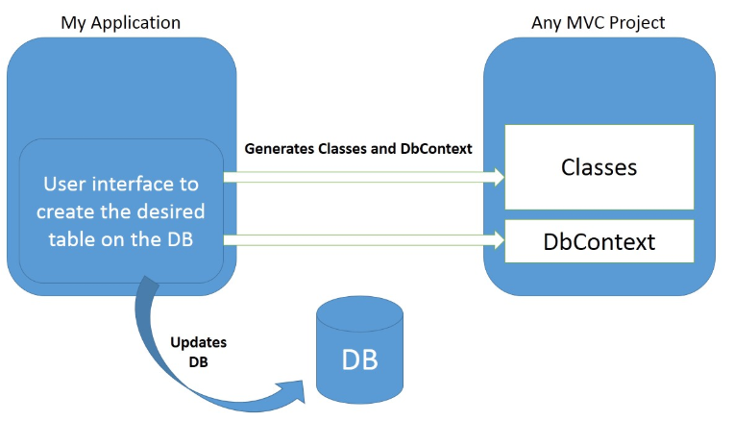
Techniques, model
ASP.Net MVC 5
Front-End technologies
Entity Framework
MVC stands for Model View Controller.
HTML/CSS.
Jquery, Ajax.
Using Entity Framework Model: Code First

Slide 14
Functional Requirement

Slide 15
Functional Requirements
01
Login
In order to shopping, an authentication is required.
Integrate Login by Google, Facebook.
Registration
02
Registration a new account: username, email, full name, password. The default role of new account is user.
03
Details User
User can view details of them self. Admin can view details of a user..
Update User
04
User can update details of them self : full name, avatar, description and email.
Admin can update details of a user include role.

Slide 16
Functional Requirements
05
Search Foods/ Drinks
User can find the food based on name or range of money or category or kind. All users can use this function (login is not required).
View Details Product
06
View details of a products.
All users can use this function (login is not required).
07
Shopping
Add to Cart
Update Quantity a Product In Cart
Remove a Product In Cart
Send mail to user
08
Send mail to user the details of the order to notify to user that order is success .

Slide 17
Functional Requirements
09
Integrate online payment
User can pay online via PayPal.
Only Customer can do this function.
View 3 New Products
10
Show 3 new products.
All users can use this function (login is not required).
11
Shopping
Add to Cart
Update Quantity a Product In Cart
Remove a Product In Cart
Integrate Messenger Facebook
12
Integrated Messenger Facebook for users to chat directly with admin.
All users can use this function (login is not required).

Slide 18
Functional Requirements
13
Create product
Create new Food. Only Admin role has permission to do this function.
Update Product
14
Update information of the selected food: name, image, price, category, quantity,...
Only Admin role has permission to do this function.
15
Create account
Create new Account.
Only Admin role has permission to do this function.
Update Account
16
Update information of the selected Account: full name, email, avatar, description and role.
Only Admin role has permission to do this function.

Slide 19
Hardware/Software Requirement

Slide 20

For developer
Hardware
Software
CPU: Pentium IV 2.0 GHz or higher
Device: Laptop, mobile
RAM: 8 GB or higher
OS: Windows 10 professional
Environment: Microsoft .NET Framework 4.8
Database Management System: Microsoft SQL Server 2017 or Higher
IDE: Microsoft Visual Studio 2019
Web Server: Internet Information Services (IIS).
Browser: Chrome, Microsoft Edge, Coc Coc

Slide 21
For User
Hardware
Software
CPU: Pentium IV 2.0 GHz or higher
Device: Laptop, mobile
RAM: 4 GB or higher
OS: Windows 8 or higher.
Browser: Chrome, Microsoft Edge, Coc Coc.

Slide 22
Summary

Slide 23




Process using of user
Guest
Confirm received user
Guest login with authorized customer.
Done Checkout Shopping
Go to checkout
User checkout with product in cart
Customer
Choose method payment
Shopping

Slide 24
Process using of admin
Manage Store, Zone, Street, Venues
View Dashboard
CRUD Store, Zone, Street, Venues
Manage system.
Manage main business.
Role Admin
Manage Account
CRUD account and permission.

Slide 25


Summary
With Customer
The best choice for now when COVID-19 is dominating.
Hana Shop
FAST
FOOD
Customer can easy at home and order food come.
Customer can use by website.
With Admin
Admin can easy manage Hana Shop Online Food by website.

Slide 26

Son Hoang
Role: Power Point, Programmer, Business analyst, Designer, Report.

Slide 27
Kha Gia
Role: Programmer, designer, report.

Slide 28
Thank you
For listening presentation.

Slide 29
Q & A
About the Hana Shop

